Slide 1
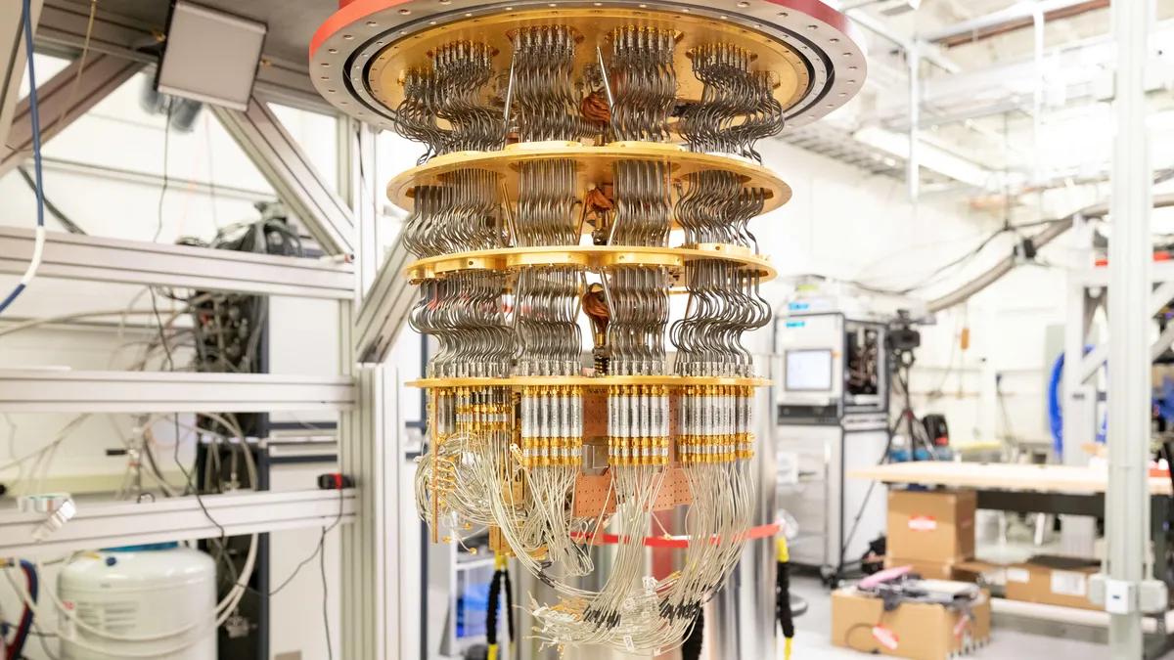

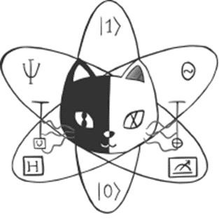



Bath’s 2023 Quantum Bootcamp

Slide 2





Slide 3
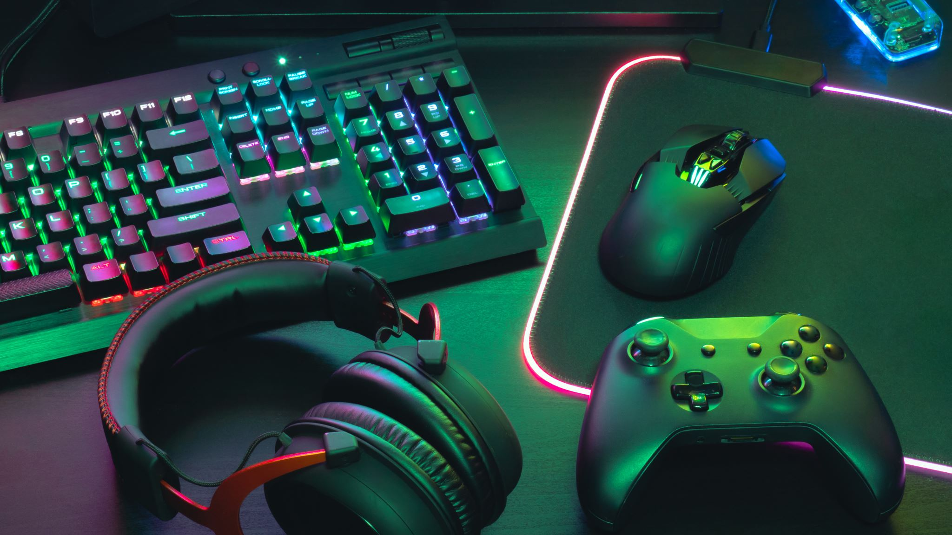
What are we doing today?
Learning about quantum tech
Playing with Quantum Software
Hearing from experts in the Quantum arena
Having fun!

Slide 4
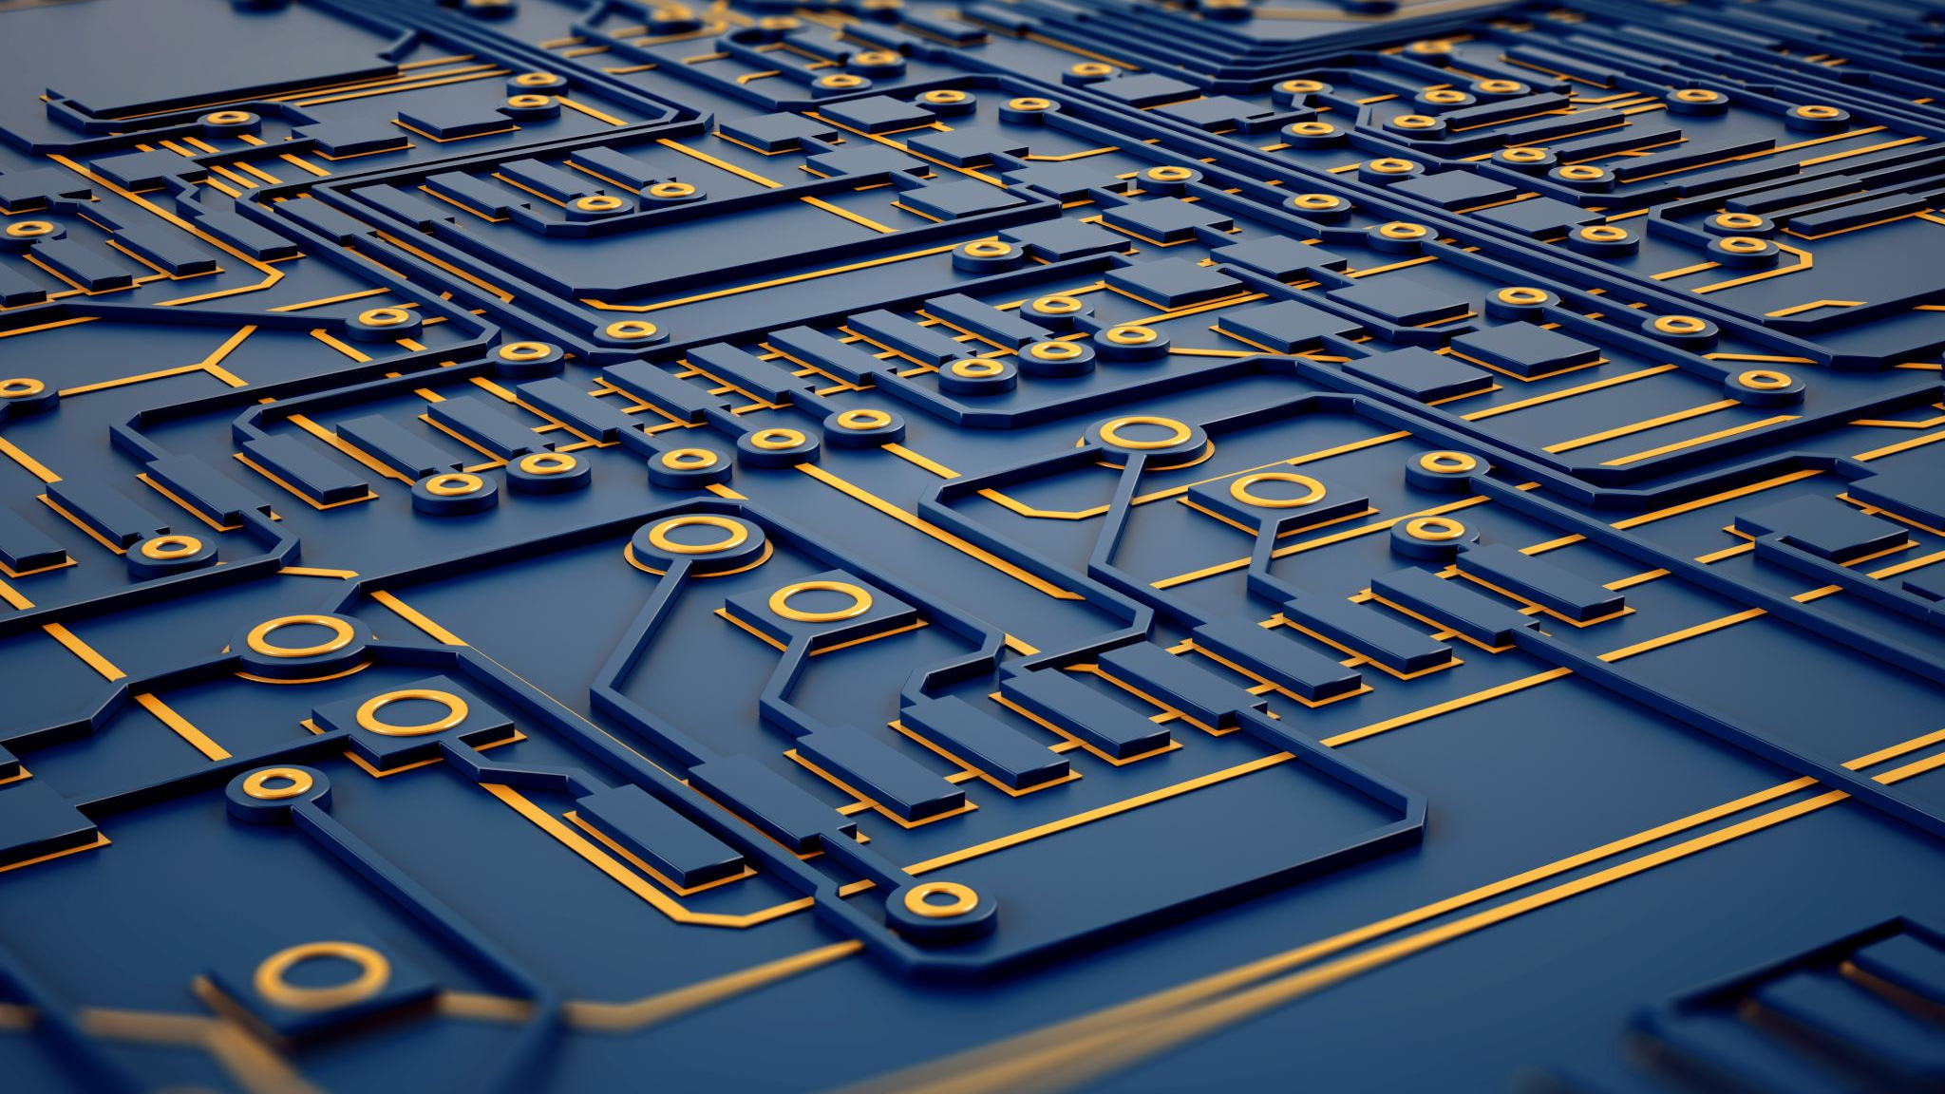
Quantum Tech: What? Why? Where?

Slide 5
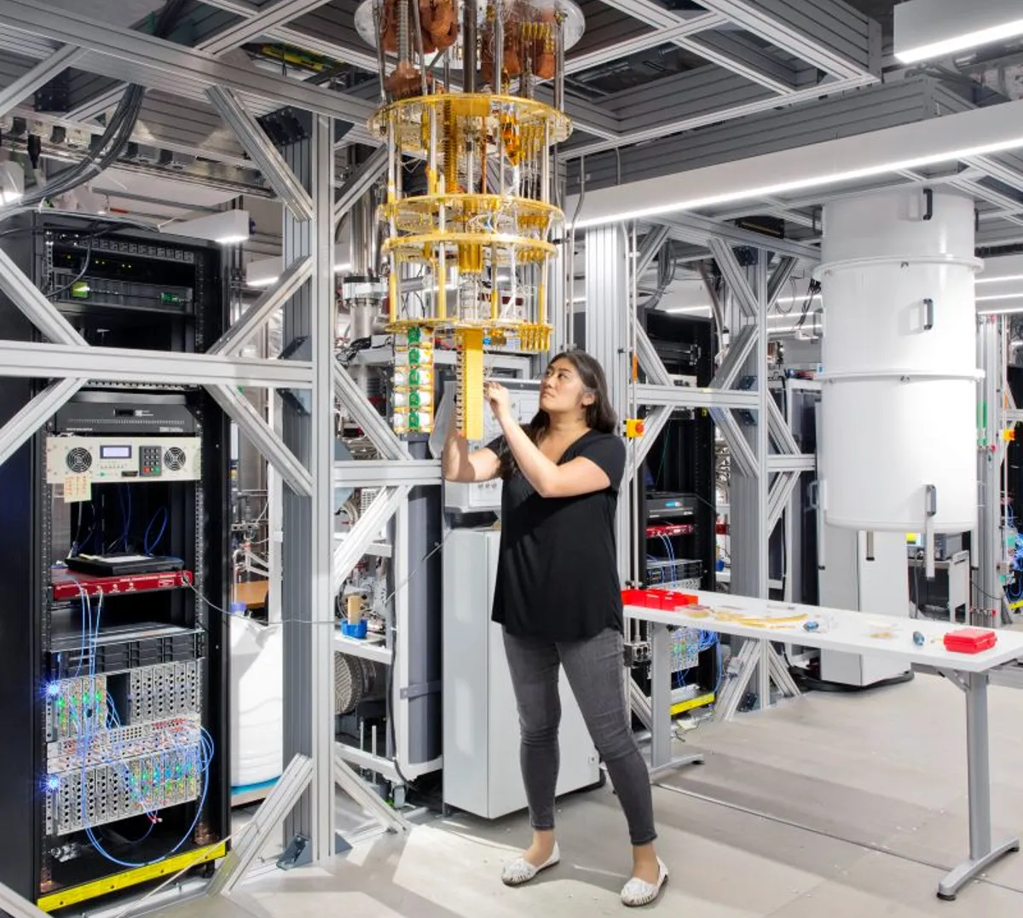

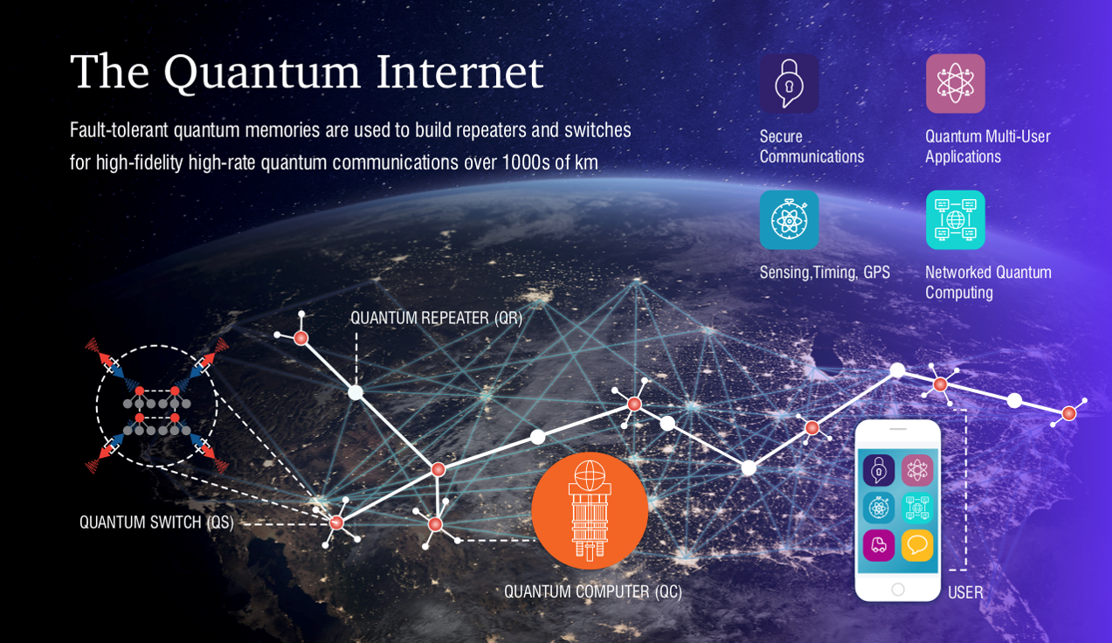
Quantum technologies
Quantum technologies exploit the unique properties of quantum physics to achieve functionality and performance that cannot be achieved using classical physics.

Slide 6
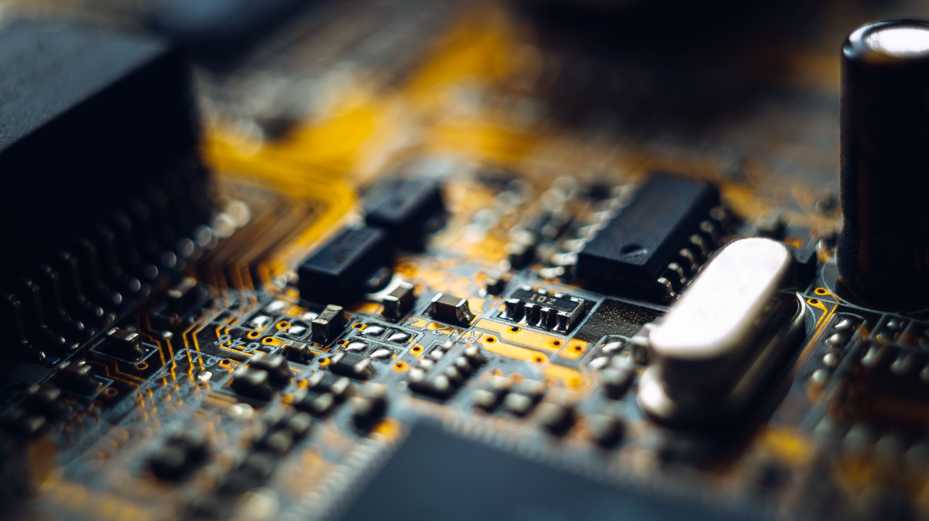
Not all quantum computers are equal

Slide 7
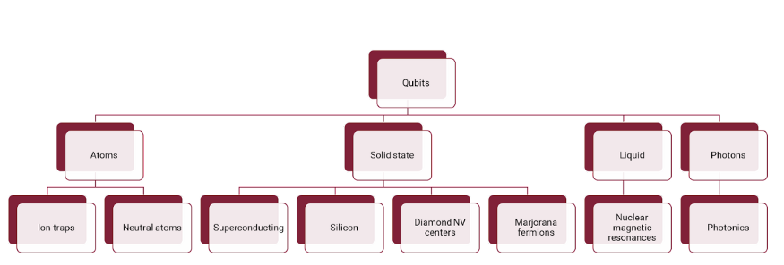
https://medium.com/@DigiCatapult/which-technology-will-win-the-quantum-race-154e38c0b227

Slide 8

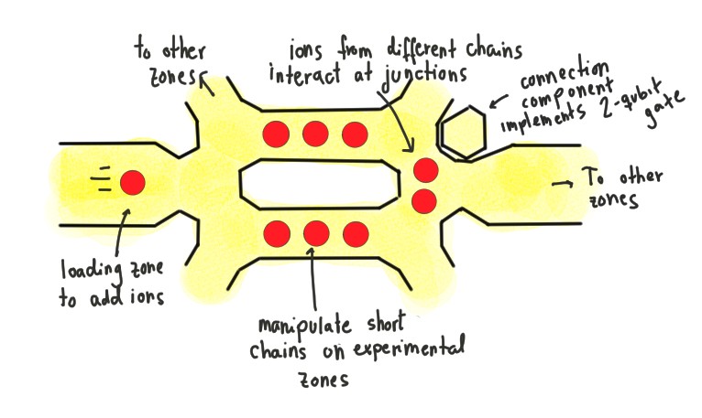



Ion traps
Ion = Atoms which have lost or gained an electron, and are electrically charged.
Although a static electric field can’t trap an ion on its own, the ions can be trapped by an oscillating electric field in a Paul trap.
Once trapped the ions can be cooled using lasers, and then manipulated into different quantum states using lasers of different frequencies.

Slide 9
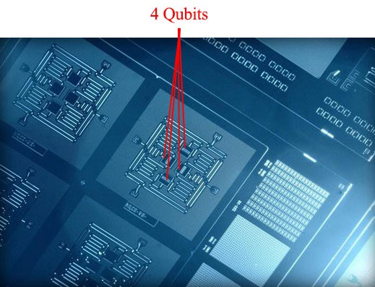
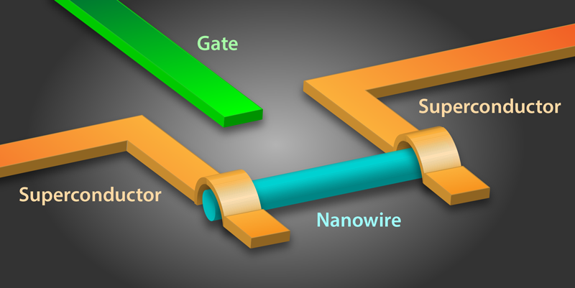



Superconducting qubits
Superconducting qubits are “artificial atoms” where the two quantum states of the qubit are represented by different resonant vibrations in electric circuits with superconducting Josephson junctions
The qubit states are manipulated by pulses of microwave radiation and like atomic qubits, need to be kept at very low temperatures.
When Google claimed “quantum supremacy”, they used a 53 bit superconducting device.

Slide 10
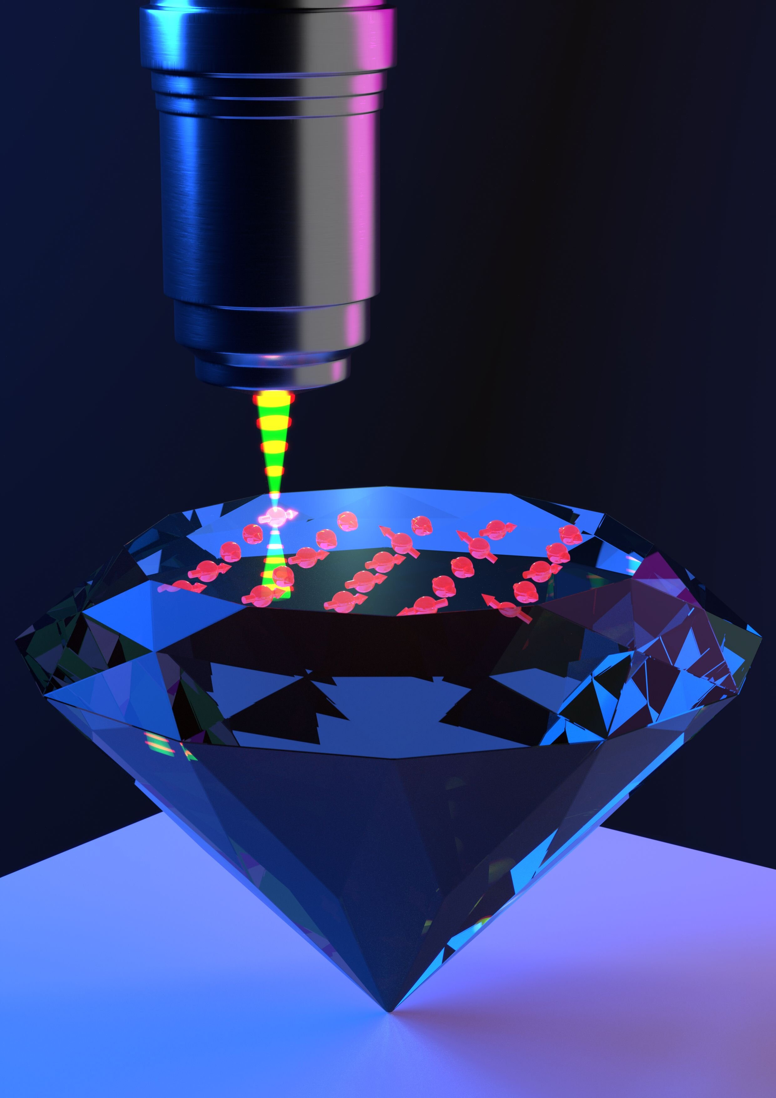
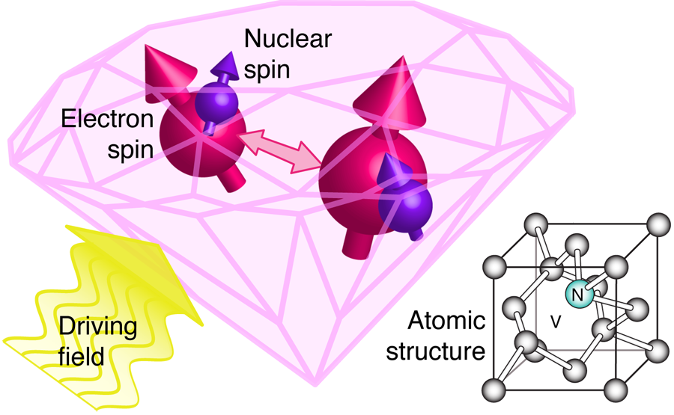

Diamond NV Centers
A nitrogen vacancy (NV) centre is a defect in a diamond’s crystal lattice, formed when a nitrogen atom is substituted for a carbon atom next to a vacant carbon atom.
Electrons trapped in the vacancy form a “colour centre” which can act as an “artificial atom”.
When a magnetic field is applied the two quantum states of the qubit are represented by different energy levels of the “colour centre”.
One-qubit and two-qubit gates are possible. In the two-qubit gates the nuclear spin of an atom is the target gate, so the gates are asymmetric. The diamond NV centre gates have slightly higher error rates than the other qubits described above.
Diamond is formed under high temperature and pressure and each carbon atom in the diamond lattice has four stiff, stable covalent bonds with other atoms. This reduces
lattice vibration and increases coherence times. So, unlike other solid state technologies, qubits can be used at higher temperatures

Slide 11
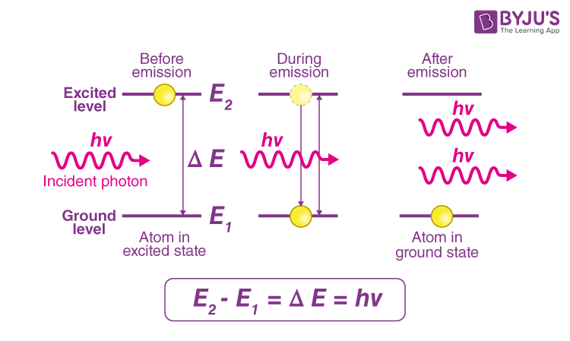
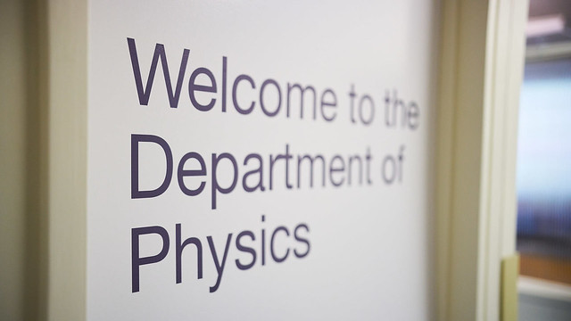
Photonic quantum computing
WE ARE LEAVING THESE TO THE PROFESSIONALs!

Slide 12

Today

Slide 13
The schedule
Date & Time | Event
Saturday 18th / 9:00-10:00 | Opening Ceremony
10:00-10:30 | Quantum 101
10:30-11:00 | Python 101
11:00-12:00 | Sponsor talk
12:00-12:30 | qBraid
12:30-13:00 | Academic talk
13:00-14:00 | Lunch Break
14:00- Sunday 19th 14:00 | Coding period
14:00-16:00 | Lunch Break
16:00-16:30 | Quantum Universal Education
16:30-17:00 | WOMANIUM
17:00-17:30 | Closing ceremony
Monday Morning | Price announcements Physoc social media

Slide 14
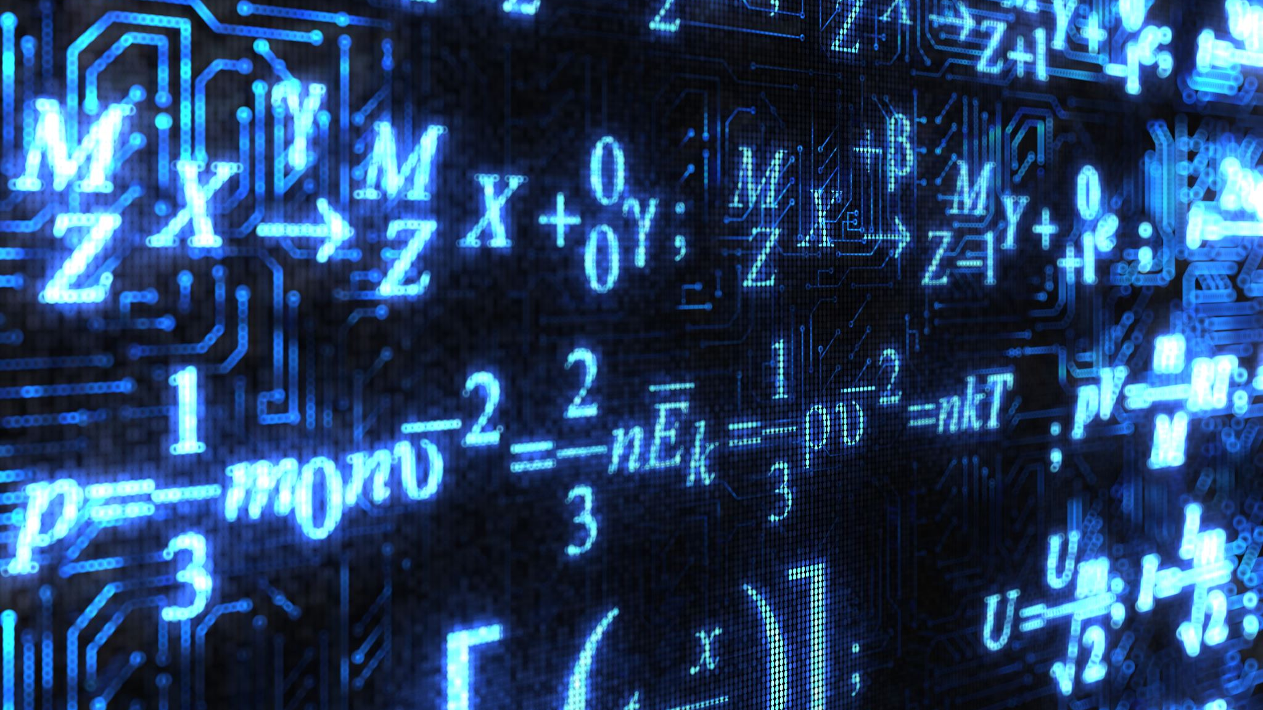
Quantum 101
1

Slide 15
The schedule
Date & Time | Event
Saturday 18th / 9:00-10:00 | Opening Ceremony
10:00-10:30 | Quantum 101
10:30-11:00 | Python 101
11:00-12:00 | Sponsor talk
12:00-12:30 | qBraid
12:30-13:00 | Academic talk
13:00-14:00 | Lunch Break
14:00- Sunday 19th 14:00 | Coding period
14:00-16:00 | Lunch Break
16:00-16:30 | Quantum Universal Education
16:30-17:00 | WOMANIUM
17:00-17:30 | Closing ceremony
Monday Morning | Price announcements Physoc social media

Slide 16
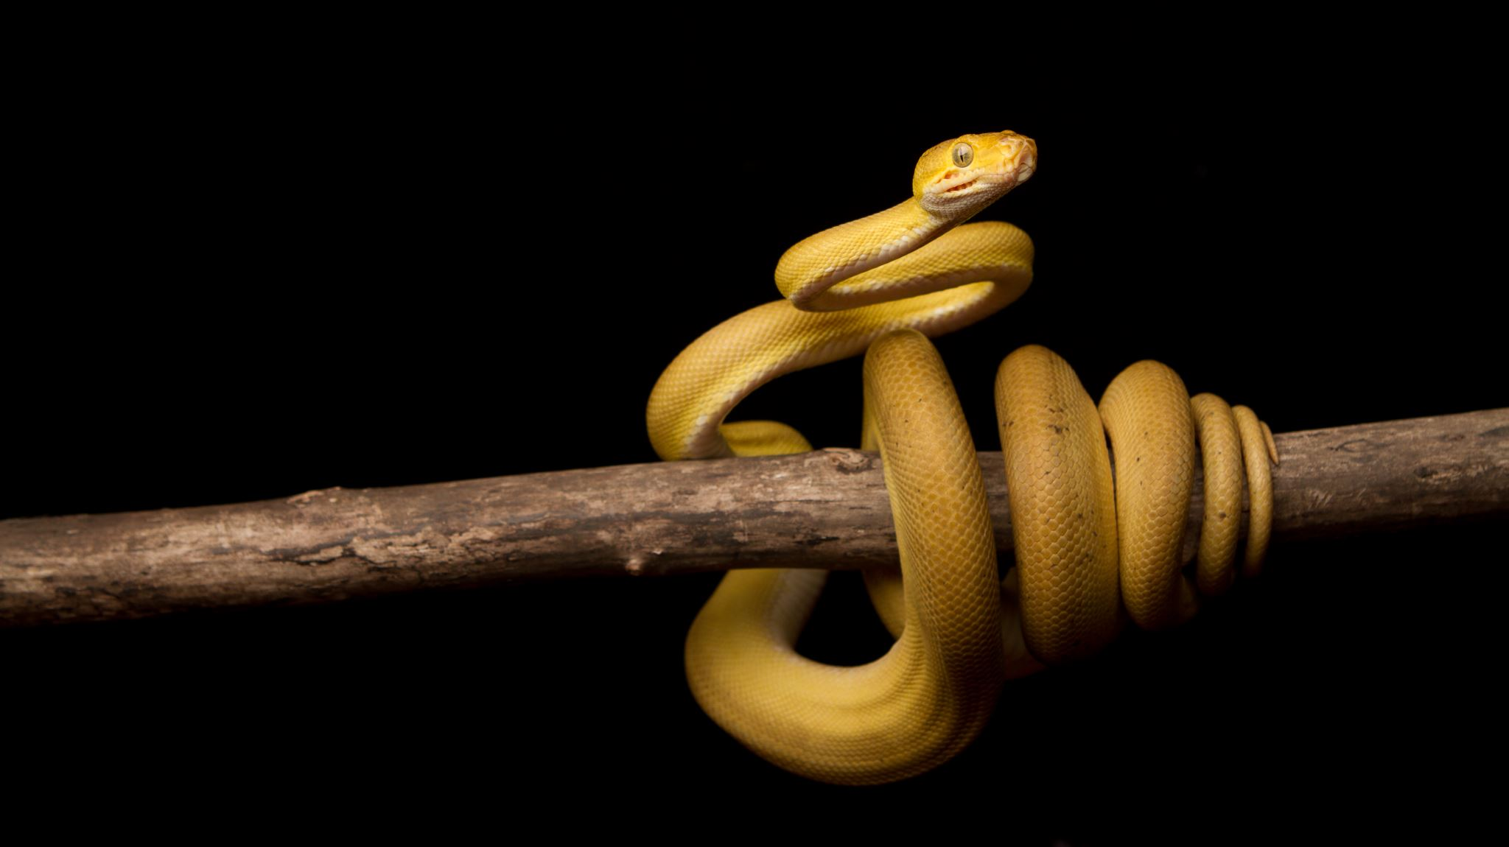
Python 101
1

Slide 17
The schedule
Date & Time | Event
Saturday 18th / 9:00-10:00 | Opening Ceremony
10:00-10:30 | Quantum 101
10:30-11:00 | Python 101
11:00-12:00 | Sponsor talk
12:00-12:30 | qBraid
12:30-13:00 | Academic talk
13:00-14:00 | Lunch Break
14:00- Sunday 19th 14:00 | Coding period
14:00-16:00 | Lunch Break
16:00-16:30 | Quantum Universal Education
16:30-17:00 | WOMANIUM
17:00-17:30 | Closing ceremony
Monday Morning | Price announcements Physoc social media

Slide 18

Singapore based quantum computing company, founded in 2018 as a startup of Singapore's Centre for Quantum Technologies. Entropica develops tools, algorithms and software for quantum optimisation.

Slide 19
The schedule
Date & Time | Event
Saturday 18th / 9:00-10:00 | Opening Ceremony
10:00-10:30 | Quantum 101
10:30-11:00 | Python 101
11:00-12:00 | Sponsor talk
12:00-12:30 | qBraid
13:00-14:00 | Lunch Break
14:00- Sunday 19th 14:00 | Coding period
14:00-16:00 | Lunch Break
16:00-16:30 | Quantum Universal Education
16:30-17:00 | WOMANIUM
17:00-17:30 | Closing ceremony
Monday Morning | Price announcements Physoc social media
13:00-14:00 | Lunch Break

Slide 20

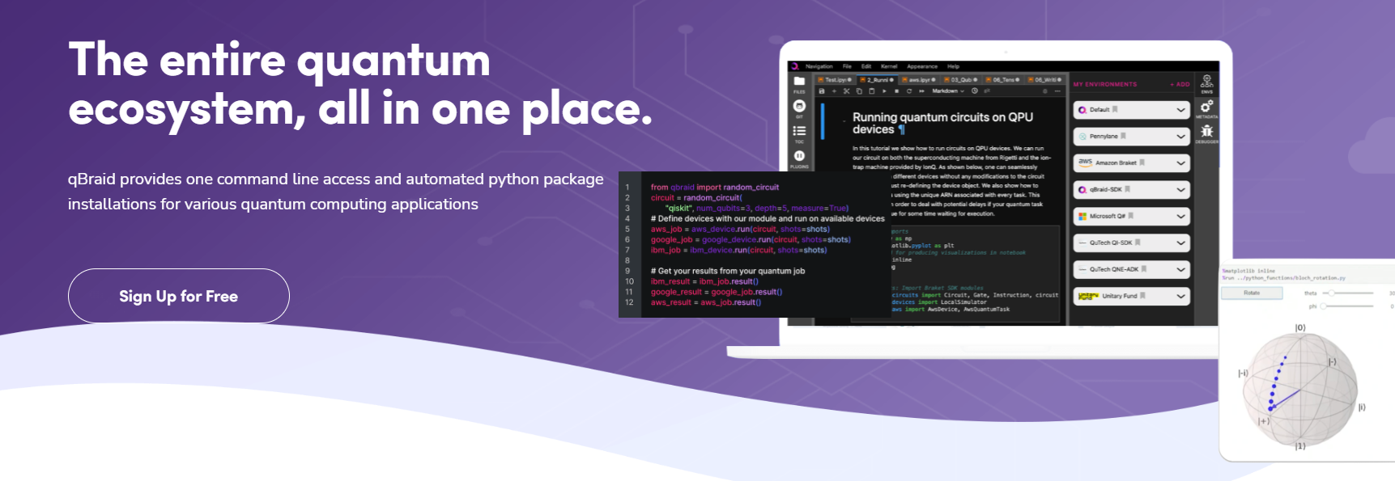
You will use real quantum machines today!
qBraid is a cloud platform for quantum software development

Slide 21
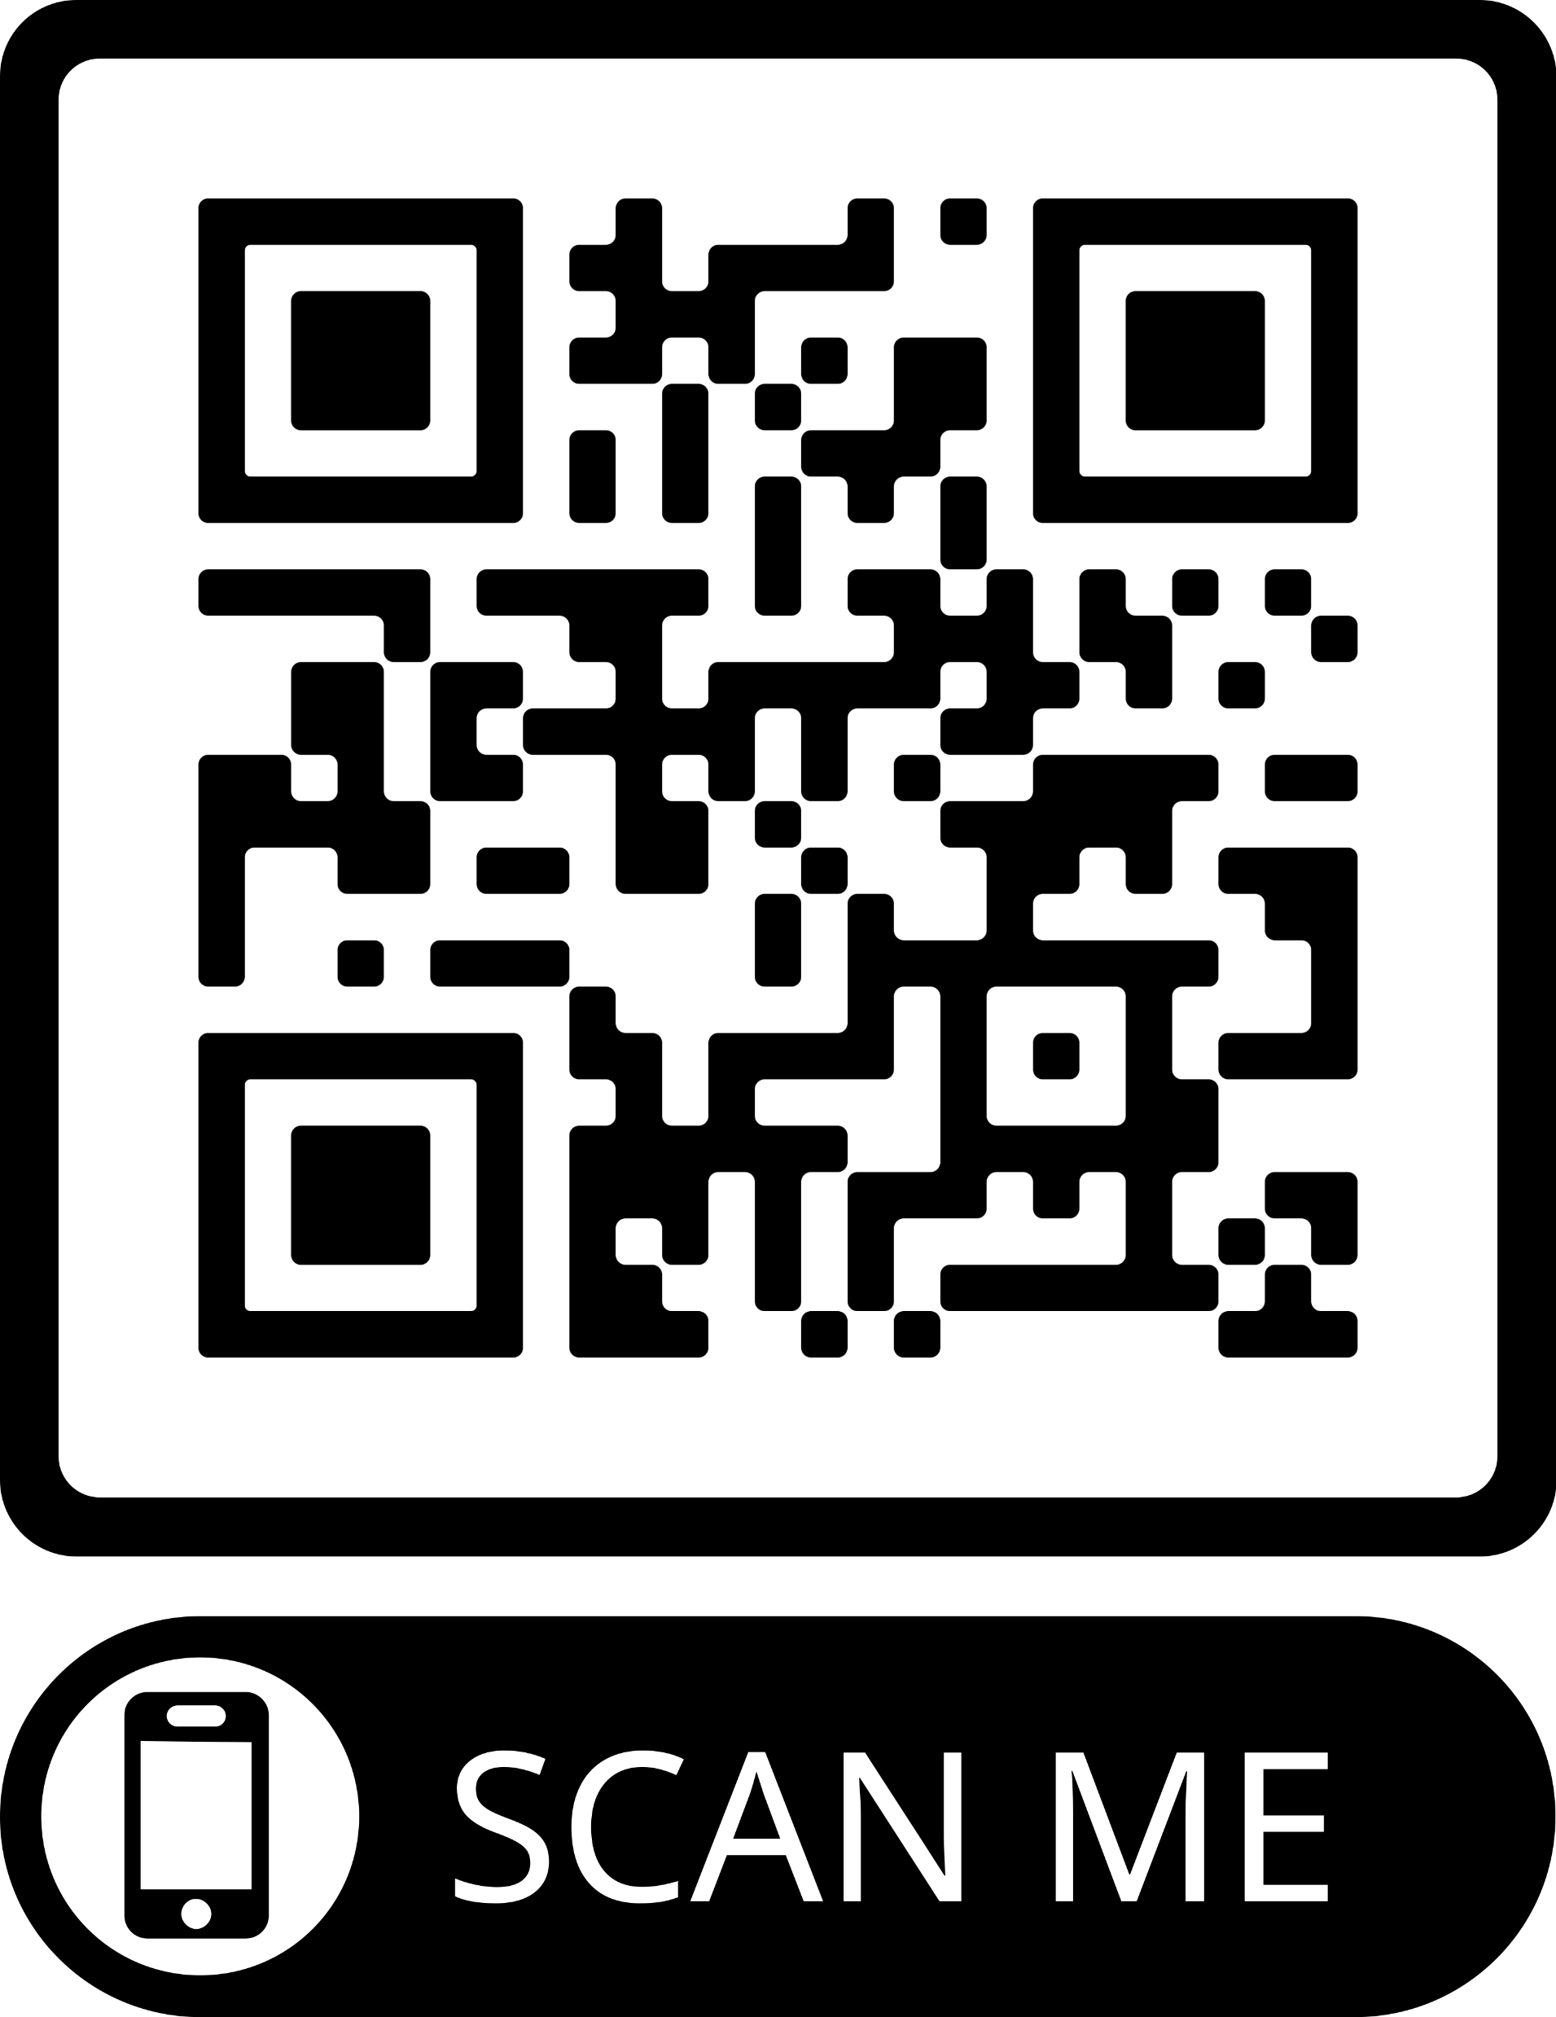
https://discord.gg/KtEwsR2TZE

Slide 22
The schedule
Date & Time | Event
Saturday 18th / 9:00-10:00 | Opening Ceremony
10:00-10:30 | Quantum 101
10:30-11:00 | Python 101
11:00-12:00 | Sponsor talk
12:00-12:30 | qBraid
12:30-13:00 | Academic talk
13:00-14:00 | Lunch Break
14:00- Sunday 19th 14:00 | Coding period
14:00-16:00 | Lunch Break
16:00-16:30 | Quantum Universal Education
16:30-17:00 | WOMANIUM
17:00-17:30 | Closing ceremony
Monday Morning | Price announcements Physoc social media
13:00-14:00 | Lunch Break

Slide 23
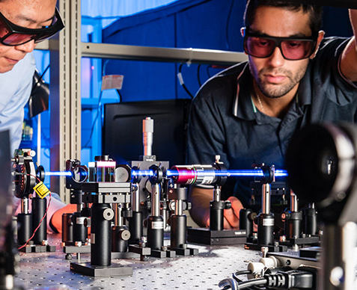
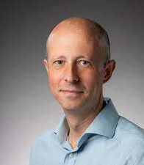

Quantum in Bath
Dr Peter Mosley, Senior Lecturer, Department of Physics
Centre for Photonics and Photonic Materials
Centre for Nanoscience and Nanotechnology
My group carries out research on quantum fibre photonics. Making use of the state-of-the-art optical fibre fabrication facility within the Centre for Photonics and Photonic Materials (CPPM), we investigate how fibre can advance a wide range of areas within photonic quantum technologies. These include low-noise sources of heralded single photons in pure quantum states, high-efficiency frequency conversion between different wavelength bands for quantum networks, and low-loss fully-fibre-integrated vapour cells for room-temperature quantum memory. To achieve these goals, we design and fabricate both solid-core photonic crystal fibre and hollow-core fibre. My group is also active in topological photonics, where we recently demonstrated the first fibre that guides topologically-protected modes.

Slide 24
The schedule
Date & Time | Event
Saturday 18th / 9:00-10:00 | Opening Ceremony
10:00-10:30 | Quantum 101
10:30-11:00 | Python 101
11:00-12:00 | Sponsor talk
12:00-12:30 | qBraid
12:30-13:00 | Academic talk
13:00-14:00 | Lunch Break
14:00- Sunday 19th 14:00 | Coding period
14:00-16:00 | Lunch Break
16:00-16:30 | Quantum Universal Education
16:30-17:00 | WOMANIUM
17:00-17:30 | Closing ceremony
Monday Morning | Price announcements Physoc social media

Slide 25
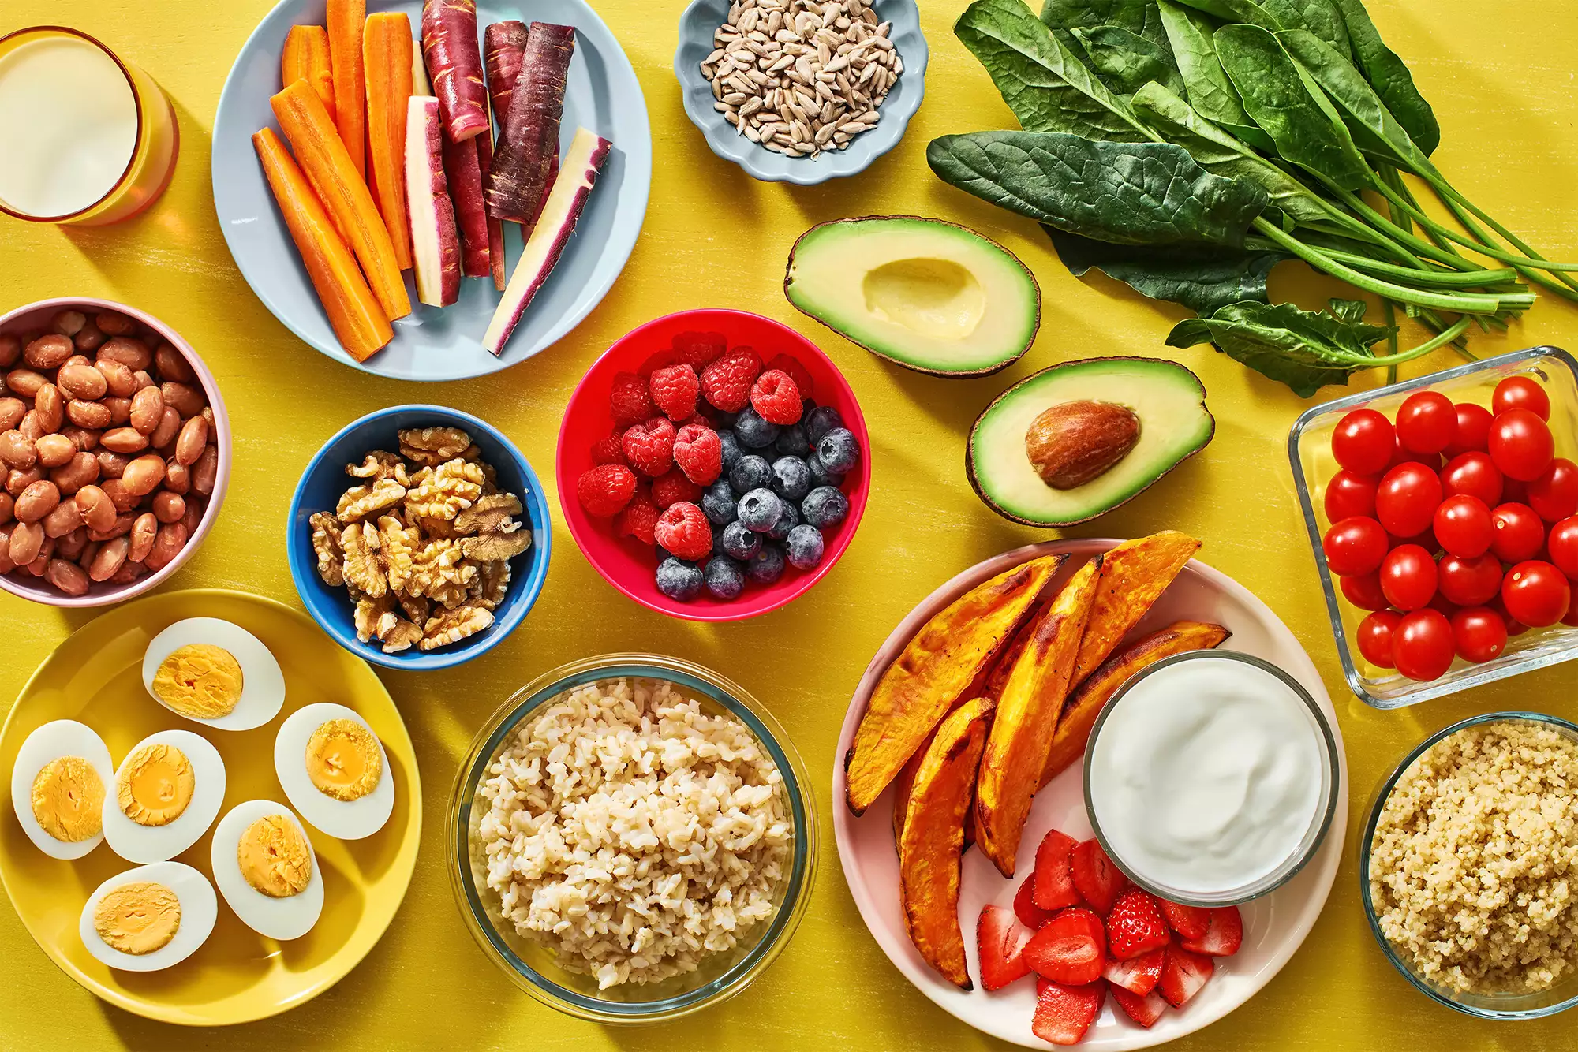
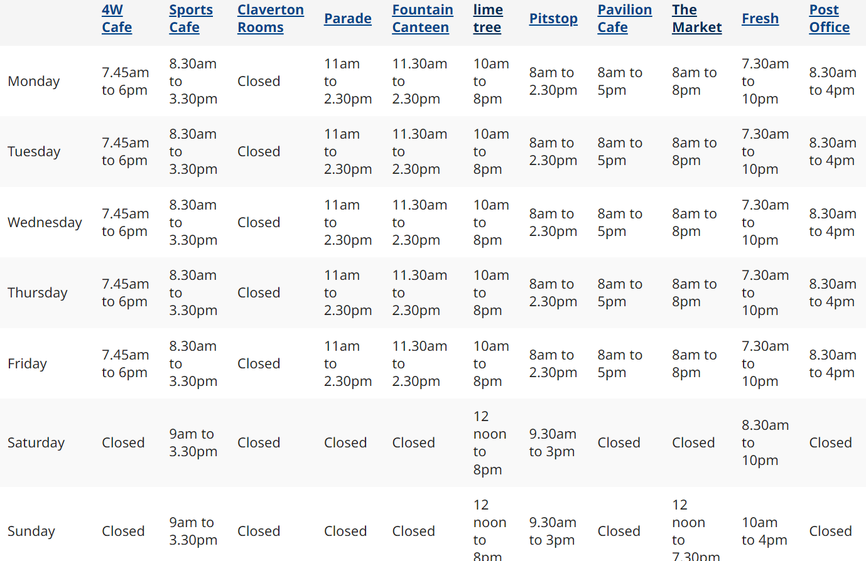
Food

Slide 26
The schedule
Date & Time | Event
Saturday 18th / 9:00-10:00 | Opening Ceremony
10:00-10:30 | Quantum 101
10:30-11:00 | Python 101
11:00-12:00 | Sponsor talk
12:00-12:30 | qBraid
12:30-13:00 | Academic talk
13:00-14:00 | Lunch Break
14:00- Sunday 19th 14:00 | Coding period
14:00-16:00 | Lunch Break
16:00-16:30 | Quantum Universal Education
16:30-17:00 | WOMANIUM
17:00-17:30 | Closing ceremony
Monday Morning | Price announcements Physoc social media

Slide 27
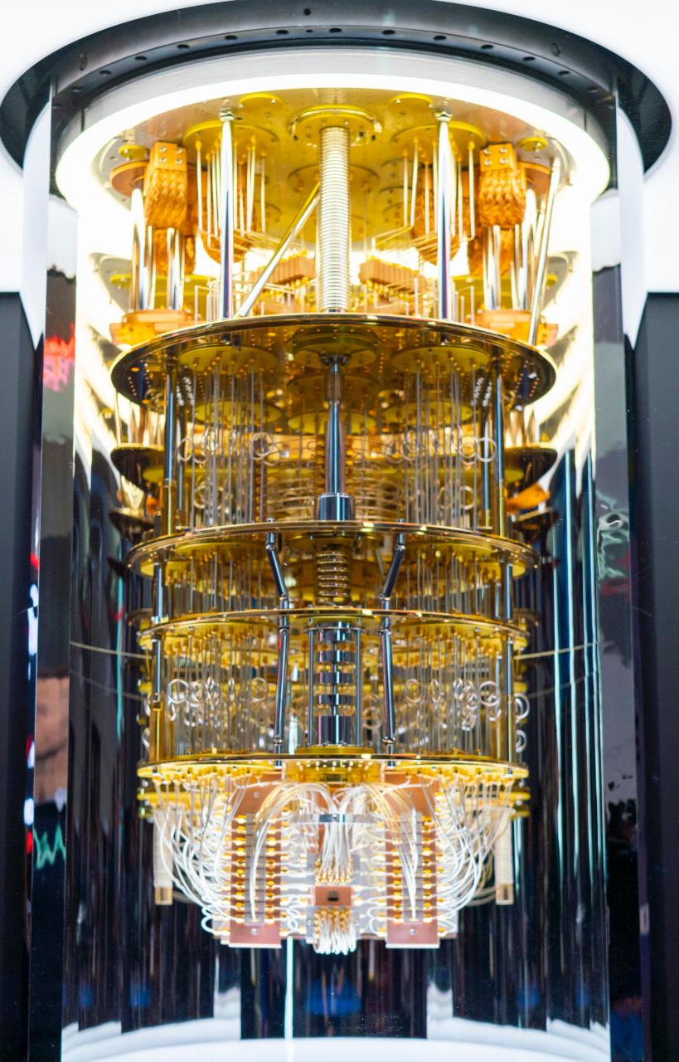
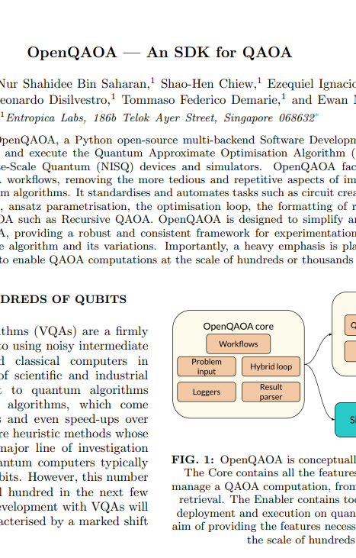
Challenge & prices
Solving binary optimisation problems with OpenQAOA (open-source multi-backend Software Development Kit)

Slide 28
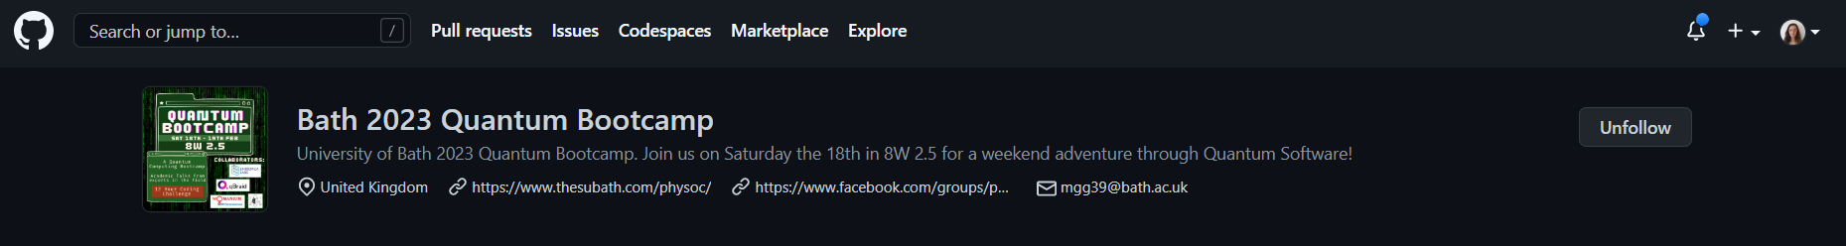
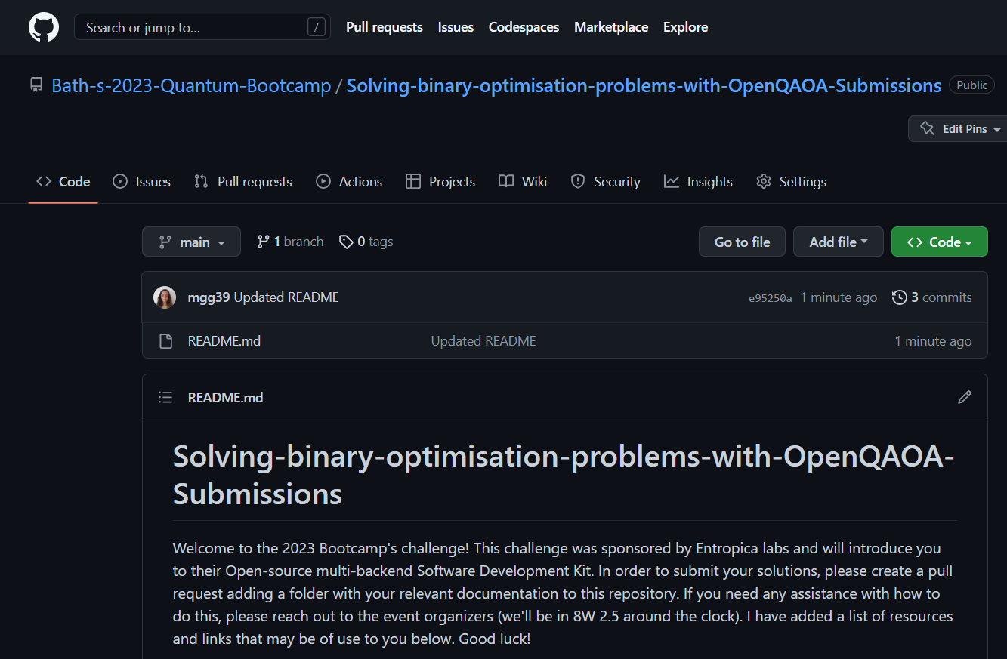

Submission through GitHub
https://github.com/Bath-s-2023-Quantum-Bootcamp/Solving-binary-optimisation-problems-with-OpenQAOA-Submissions

Slide 29
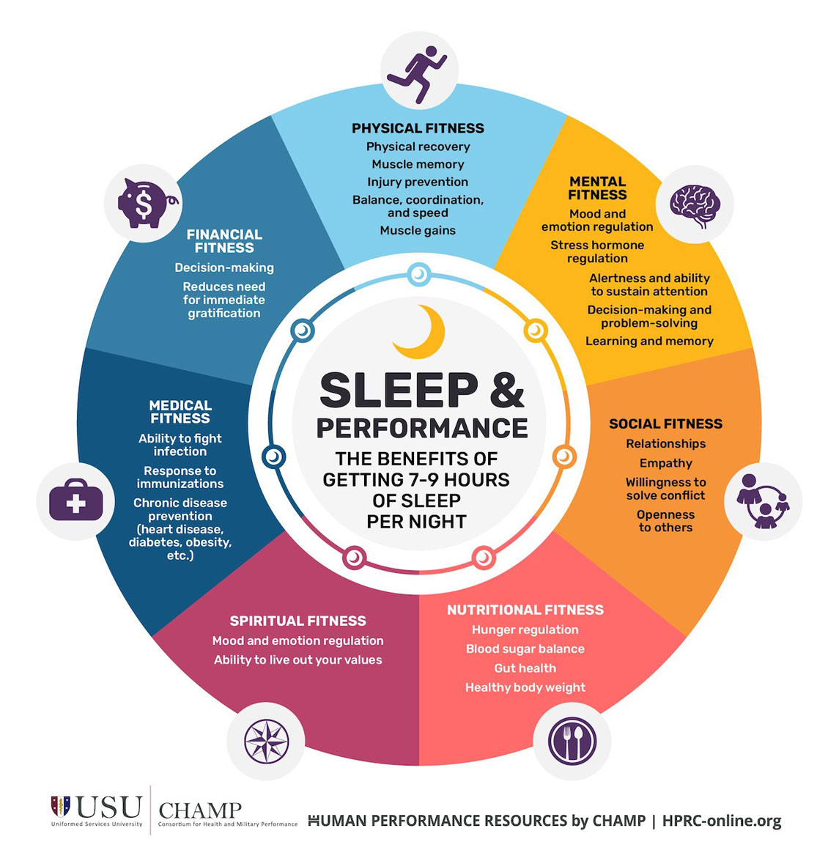
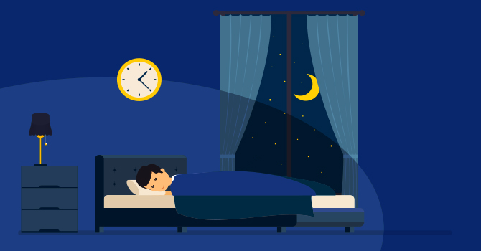
Sleep
14:00-20:00
08:00-14:00

Slide 30

Surprise Events
Look out for flash events at:
18:00 on Saturday
09:00 on Sunday

Slide 31
The schedule
Date & Time | Event
Saturday 18th / 9:00-10:00 | Opening Ceremony
10:00-10:30 | Quantum 101
10:30-11:00 | Python 101
11:00-12:00 | Sponsor talk
12:00-12:30 | qBraid
12:30-13:00 | Academic talk
13:00-14:00 | Lunch Break
14:00- Sunday 19th 14:00 | Coding period
14:00-16:00 | Lunch Break
16:00-16:30 | Quantum Universal Education
16:30-17:00 | WOMANIUM
17:00-17:30 | Closing ceremony
Monday Morning | Price announcements Physoc social media

Slide 32

Speakers

Slide 33
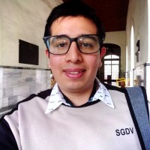
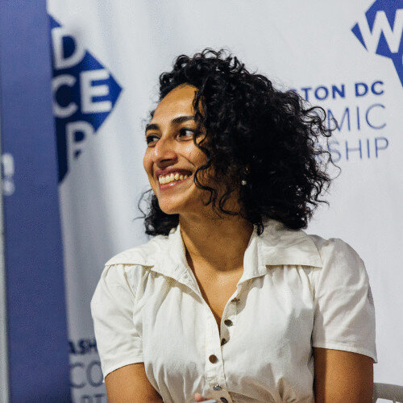
Quantum Universal Education
Womanium advances students in STEM+Entrepreneurship by introducing them to the opportunities and beauty of STEM+E by directly exposing them to the best of the industry, national and international labs, incubators, factories, manufacturing plants, design centres, and also preparing them with the right kind of knowledge, skills, outlook and perspective required to understand, rise, succeed and make their own marks in those domains.
Quantum universal education is a not-for-profit association for quantum computing education around the world! They focus on Community-driven, open-source quantum education resources anyone can help create and make more accessible.
Alberto Maldonado
Prachi J. Vakharia

Slide 34
The schedule
Date & Time | Event
Saturday 18th / 9:00-10:00 | Opening Ceremony
10:00-10:30 | Quantum 101
10:30-11:00 | Python 101
11:00-12:00 | Sponsor talk
12:00-12:30 | qBraid
12:30-13:00 | Academic talk
13:00-14:00 | Lunch Break
14:00- Sunday 19th 14:00 | Coding period
14:00-16:00 | Lunch Break
16:00-16:30 | Quantum Universal Education
16:30-17:00 | WOMANIUM
17:00-17:30 | Closing ceremony
Monday Morning | Price announcements Physoc social media

Slide 35


